Slide 1


Department of Computer Science and Engineering
AUTOMATED DETECTION OF ALZHEIMER DISEASE USING CNN ALGORITHM
Team Members Name / Register Number
Dinesh kumar V [211419104070]
Diwakar V [211419104073]
Deventhiran R [211419104055]
Guide Name & Designation
Dr.M.SANGEETHA,M.TECH.,Ph.D.,
Coordinator Name & Designation
Dr.N.PUGHAZENDI,M.E.,Ph.D.,

Slide 2
Introduction
There has been a lot of work done to process, simulate, and interpret the results of medical examinations using various imaging techniques such as MRI (Magnetic Imaging Resonance), PET (Positronemission tomography), and Computed Tomography (CT) scans. This is being done for the purpose of Computer Aided Diagnosis (CAD), which will be of vital importance to medical professionals.
In a similar vein, multiple researchers have conducted a variety of studies using MRI as the primary biomarker in order to effectively construct a Computer Assisted Diagnosis (CAD) system for the diagnosis and detection of Alzheimer's disease. Alzheimer's disease (AD), Parkinson's disease (PD), Huntington's disease (HD), and other neurodegenerative disorders are all included under the umbrella term neuro-degenerative diseases, which mostly affect the older population.
For example, Alzheimer's disease is one of the most frequent types of dementia. Several of the symptoms of Alzheimer's disease are well-known, including problems sleeping, memory loss, and dramatic shifts in mood. According to research that was published by the World Health Organization (WHO), there are roughly 40 million people around the world who are afflicted with AD. It is anticipated that this number will reach 135 million by the year 2050.

Slide 3
Objectives
The objective of using CNN in Many different architectures of Convolutional Neural Networks (CNNs) have been developed for use in classifying images and recognizing objects. When it comes to image-based categorization, handling hundreds of MRI image slices that are essentially identical across patients is a challenging task for CNN. By utilizing a 2D CNN design, it becomes difficult to confidently categorize a large number of individuals as having Alzheimer's disease, mild cognitive impairment, or normal cognition.
To solve this problem, we have streamlined the concept of patient classification based on 3D MRI while still giving due credit to the 2D features derived from the CNN framework. Here, we share our approach to extracting 2D features from MRI scans in a format that can be used in a classification system. Our experiment demonstrates the outcome of categorizing 3 patient participants into 2 groups
After reducing the dimensionality of a 2D image with principal component analysis and truncated sparse encoding (PCA+TSNE), we used a convolutional neural network (CNN) to extract generic features for classification. Despite the lackluster performance, this seems to be an improvement over probability-based categorization using a CNN that was trained from scratch. The created feature is highly malleable and can be fine-tuned to improve precision, responsiveness, and specificity

Slide 4
Literature Review
S.NO | TITLE | AUTHOR | YEAR | PUBLISHERS
1. | Multimodal Neuroimaging based Alzheimer's Disease Diagnosis using Evolutionary RVFL Classifier | Tripti Goel, Rahul Sharma | 2023 | IEEE Journal of Biomedical and Health Informatics
2. | Regression and Classification of Alzheimer’s Disease Diagnosis Using NMF-TDNet Features From 3D Brain MRI image | Huan Lao, Xuejun Zhang | 2022 | IEEE Journal of Biomedical and Health Informatics
3. | Ensembles of Patch-Based Classifiers for Diagnosis of Alzheimer Diseases | Samsuddin Ahmed, Kyu Yeong Choi | 2019 | IEEE Access

Slide 5
S.no | TITLE | AUTHOR | YEAR | PUBLISHERS
4 | Deep Learning Based Binary Classification for Alzheimer’s Disease Detection using Brain MRI Images | Emtiaz Hussain, Mahmudul Hasan | 2020 | IEEE Conference on Industrial Electronics and Applications (ICIEA)
5 | Transfer Learning for Alzheimer's Disease Detection on MRI Images | Amir Ebrahimi-Ghahnavieh, Suhuai Luo | 2019 | IEEE International Conference on Industry 4.0, (IAICT)
6 | A CNN Model: Earlier Diagnosis and Classification of Alzheimer Disease using MRI | Ahmad Waleed Salehi, Preety Baglat | 2020 | Cornell University
7 | Task-Induced Pyramid and Attention GAN for Multimodal Brain Image Imputation and Classification in Alzheimer's Disease | Xingyu Gao, Feng Shi | 2022 | IEEE Journal of Biomedical and Health Informatics

Slide 6
Problem Statement
There is no proper awareness about Alzheimer Disease. As they age, they may experience changes in your physical abilities and walking, sitting, and eventually swallowing.
Individuals may need substantial assistance with daily activities as their memory, and cognitive skills continue to decline.
At this stage, individuals may need 24/7 assistance for personal care and daily activities.
When people suffer from dementia, their ability to communicate, adapt to their environment, and eventually move is lost.
It becomes much more difficult for them to communicate pain through words or phrases.

Slide 7
Existing System
Some of the symptoms of dementia include memory loss, trouble processing language, difficulties communicating, and changes in mood. The principal impacts of the condition on a patient's mind and body go hand in hand with a significant adjustment in lifestyle and the ability to carry out ordinary duties.
The voxel, region, and patch-based techniques relied significantly on manually constructed features and feature representations since they saw segmentation jobs as classification problems. It took more time and a larger number of expertly segmented images to train classification algorithms.

Slide 8
Proposed System
Preprocessing of MR images, skull stripping (the extraction of essential parts of the brain by removing the brain membrane and unnecessary tissues), feature extraction and selection of non-redundant features from the processed MR images, application of fractal analysis on the selected features, and classification using the proposed machine learning method are all required for successful detection and classification of Alzheimer's disease from brain MR images

Slide 9
Development Environment
HARDWARE REQUIREMENTS:
Hard Disk : 500GB and Above
RAM : 8GB and Above
Processor : I5 and Above
GPU
SOFTWARE REQUIREMENTS:
Operating System : Windows 10 (64 bit)
Software : Python
Tools : Anaconda

Slide 10
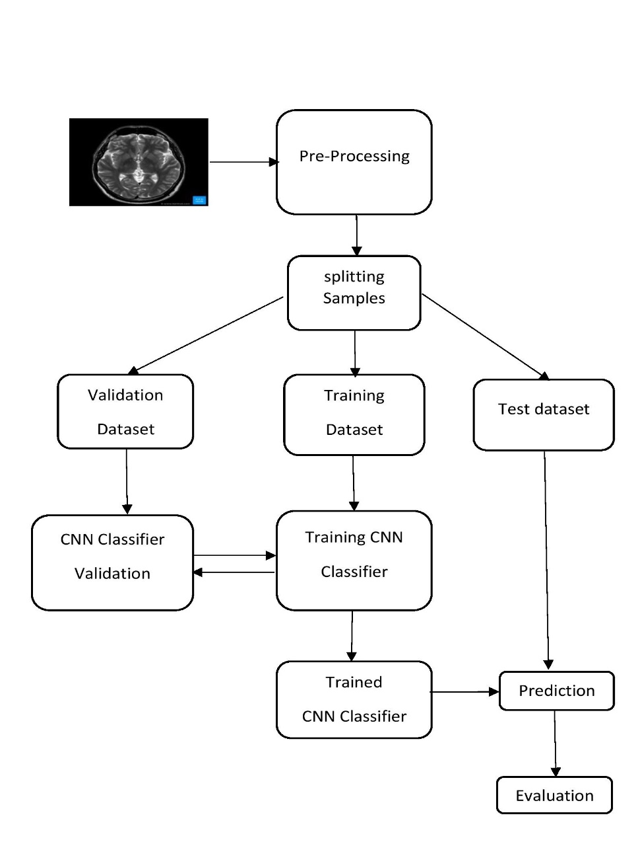
System Architecture

Slide 11
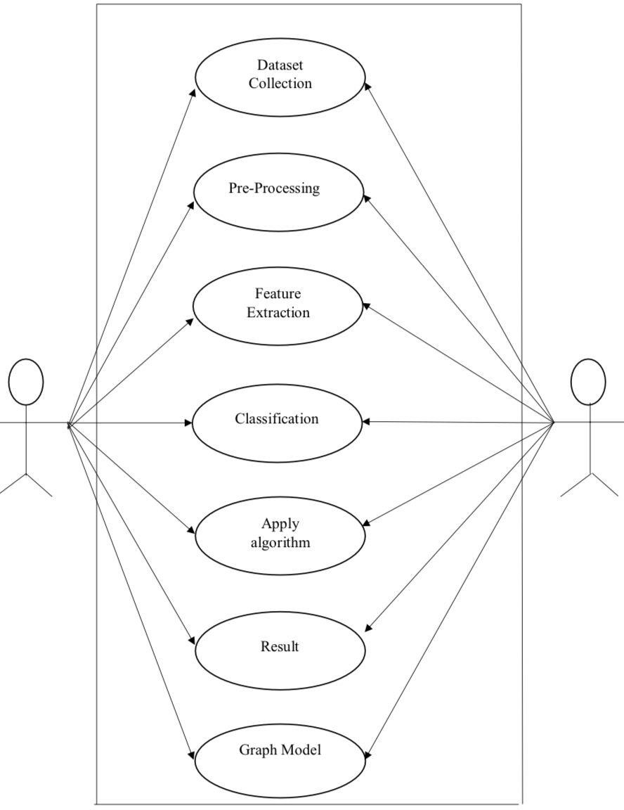
UML DIAGRAMS Use case diagram :

Slide 12
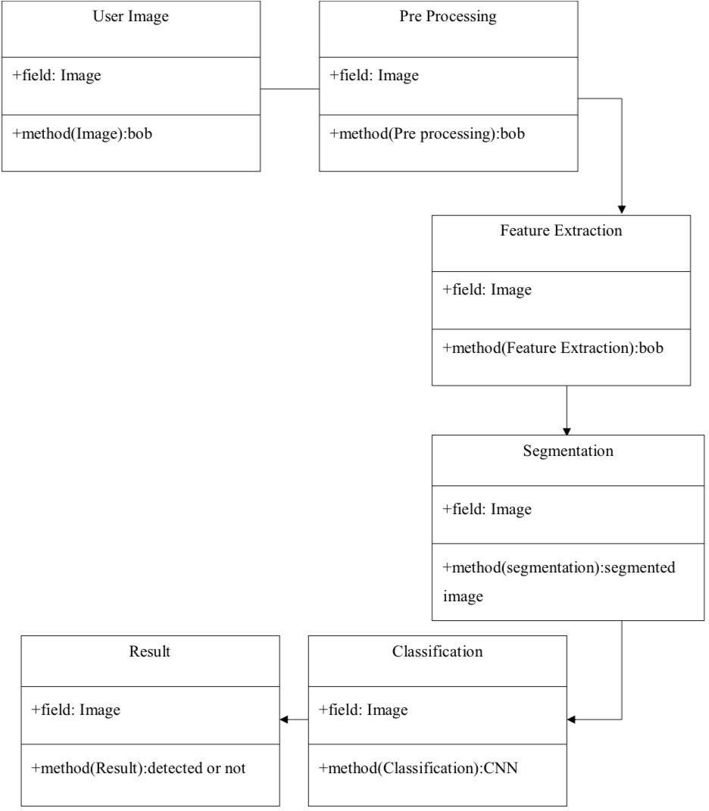
Class diagram :

Slide 13
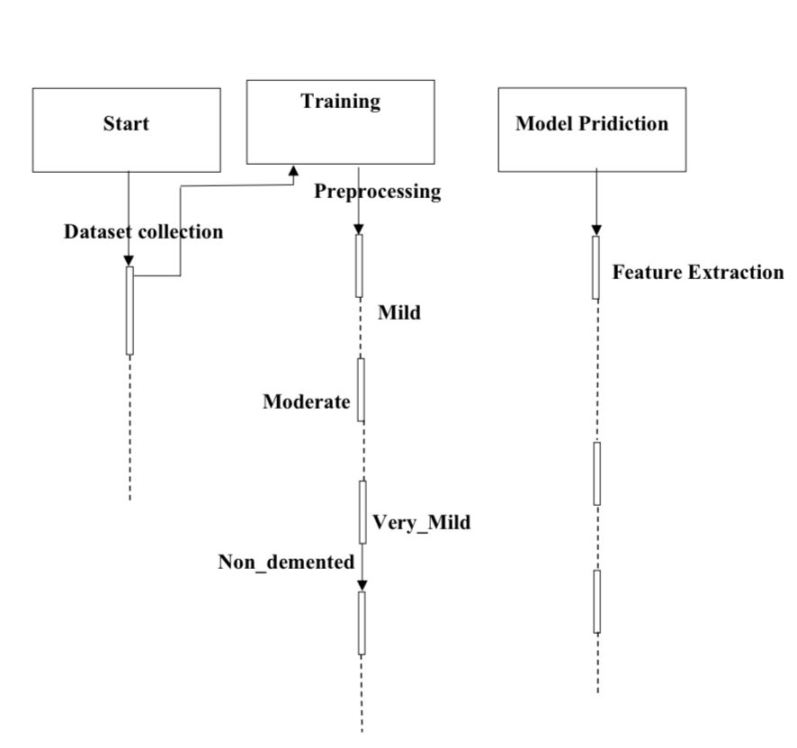
Sequence diagram :

Slide 14
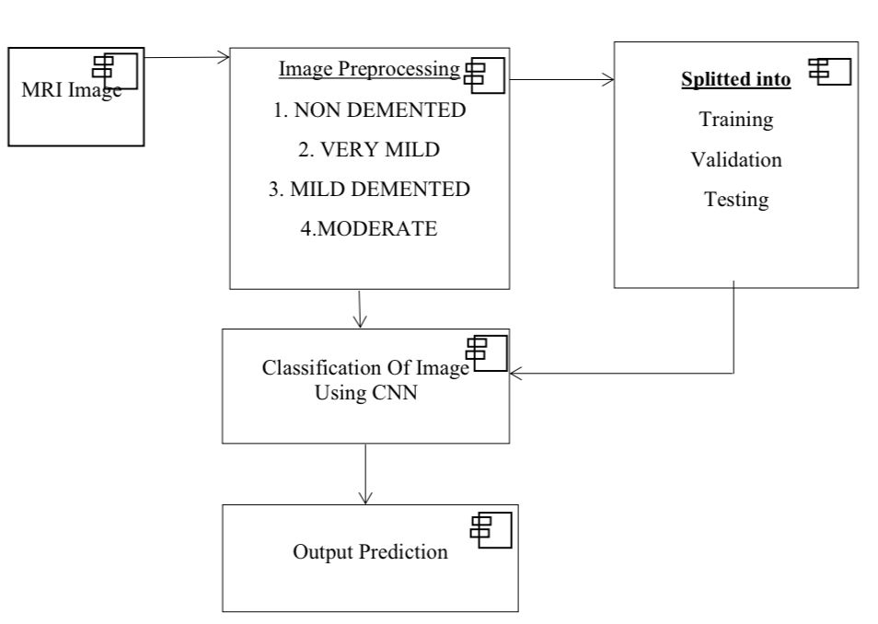
Component diagram :

Slide 15
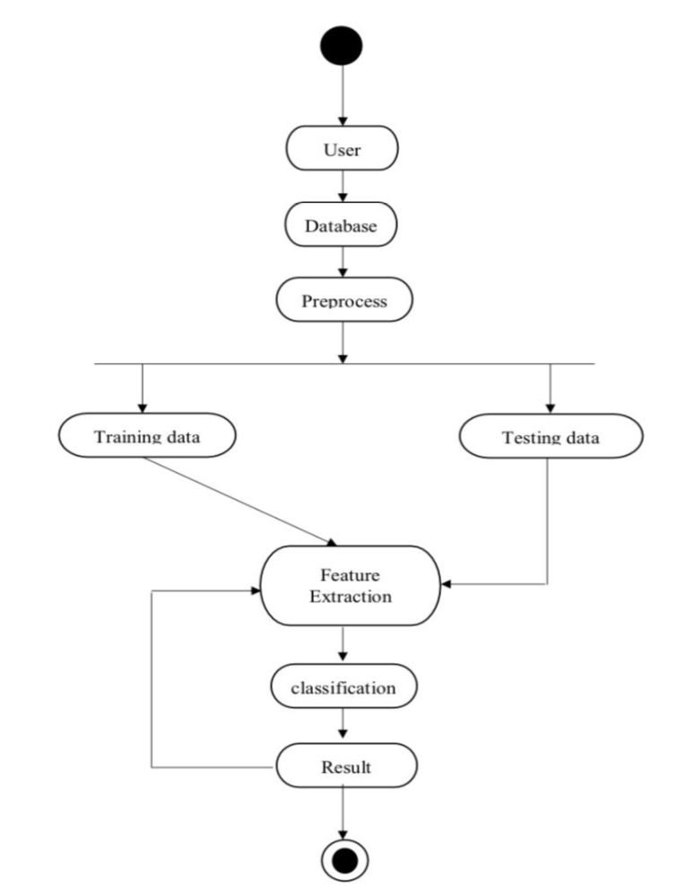
Activity diagram :

Slide 16
Module Description
MODULES :
Data collection and acquisition
Data pre-processing
Feature extraction
Classification model
Model evaluation
Model deployment

Slide 17
MODULE EXPLANATION:
1.DATASET COLLECTION AND ACQUISITION :
The dataset used for training the CNN model should be representative of the image that need to be detected. The dataset can be collected from various sources, such as public datasets or custom data collection efforts.
Data used in the preparation of this report were obtained from the publicly available Alzheimer’s Disease Neuroimaging Initiative (ADNI) database and the Open Access Series of Imaging Studies (OASIS) project database. The most recent visit in which a diagnosis was made was considered the best available “ground-truth” to train the classifiers.
2.DATA PREPROCESSING :
This step involves pre-processing of the MRI images such as skull stripping, intensity normalization, and image registration.
It is important to ensure that the images are of the same size, orientation, and spatial resolution to facilitate easy comparison and analysis.

Slide 18
3. FEATURE EXTRACTION :
This step involves extracting features from the pre-processed images, such as gray matter volume, cortical thickness, and hippocampal shape.
These features are then used to classify the images into Alzheimer's disease (AD) like Mild Demented, Moderate Demented, Non Demented and Very Mild Demented.
4. CLASSIFICATION MODEL :
The extracted features are then used to train a classification model, as convolutional neural network (CNN), to classify the images as Mild Demented, Moderate Demented, Non Demented and Very Mild Demented.
5. MODEL EVALUATION :
The trained model is evaluated using various metrics such as accuracy, sensitivity, specificity, and F1 score. The evaluation process helps to determine the effectiveness of the classification model and identify areas for improvement.

Slide 19
6. MODEL DEPLOYEMENT :
The final step involves deploying the classification model to classify new MRI images into Mild Demented, Moderate Demented, Non Demented and Very Mild Demented. The model can be deployed as a standalone application, integrated into existing healthcare systems, or used as a diagnostic tool by healthcare professionals.

Slide 20
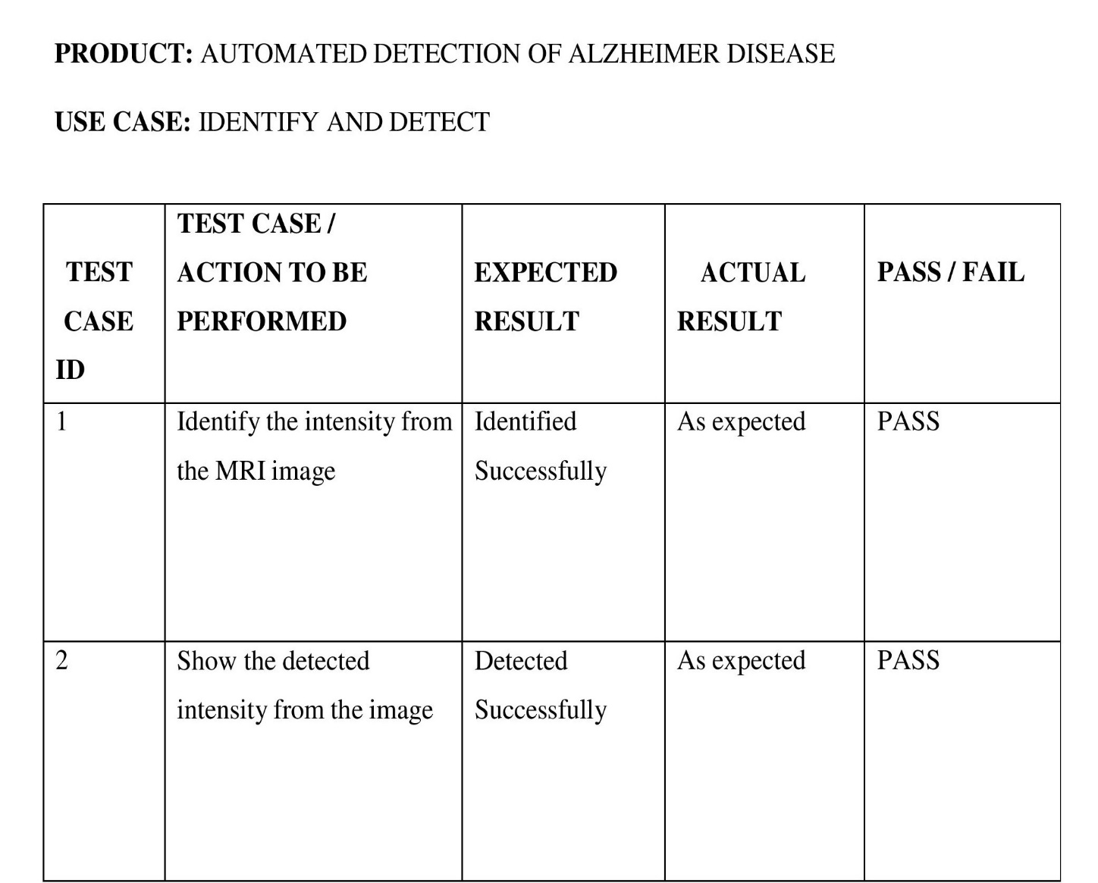
Testing

Slide 21
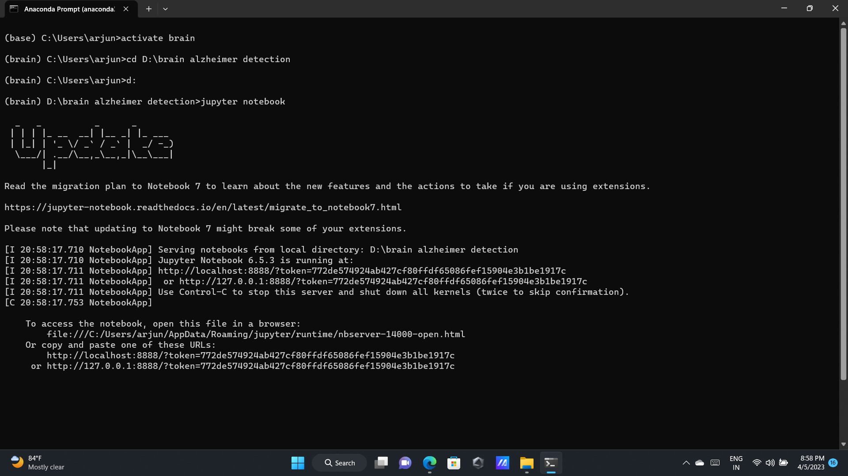
Screenshots

Slide 22
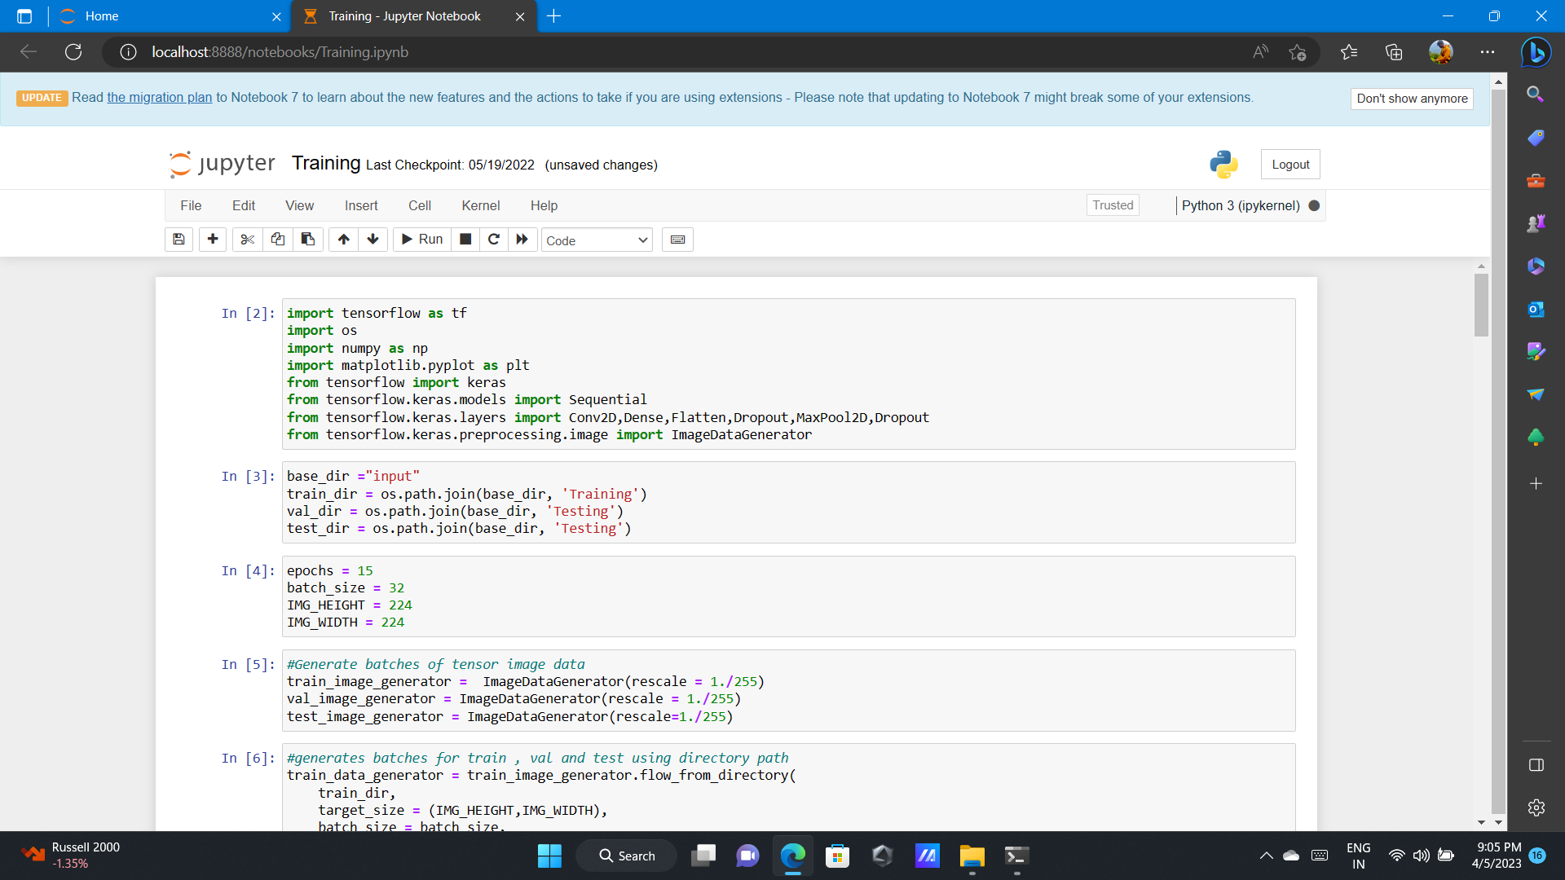

Slide 23
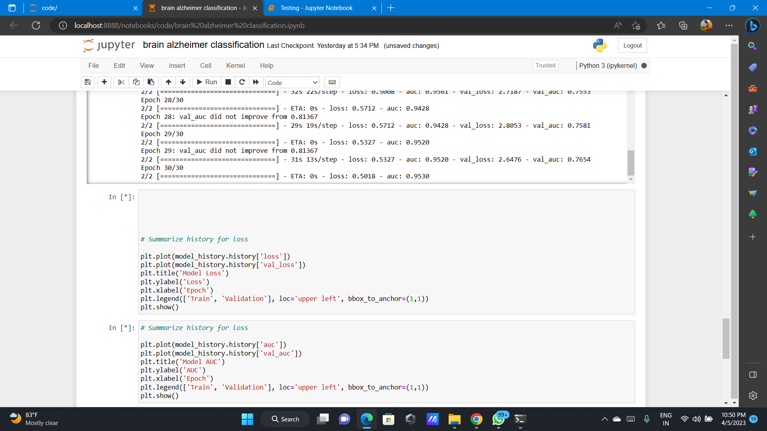

Slide 24
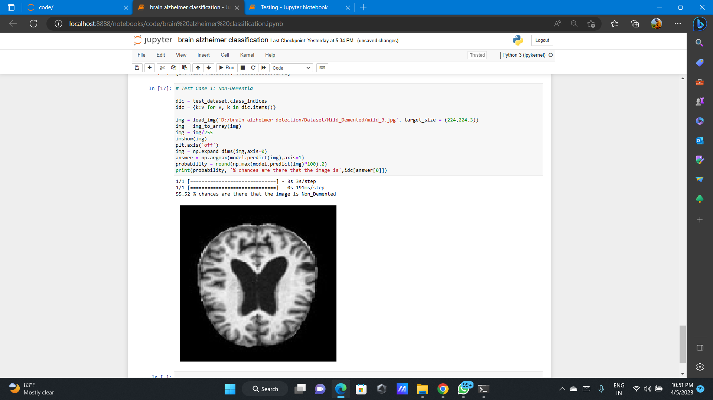

Slide 25
Conclusion
As a result, we put our theory of transfer learning from CNN to other classifiers through its paces, following the steps in sequential order. It is possible for us to draw one of the defining qualities for training the classifier is the ability to transfer learnt parameters and features from a CNN that has been trained.
If the feature transformation, selection, and classification processes are carried out in an intelligent manner, the CNN features trained classifier can achieve a higher level of performance than CNN networks itself. The performance of CNN can even be enhanced by properly modifying and tuning the architecture of CNN, as well as by appropriately optimizing the classification system.

Slide 26
Future Enhancement
There are several potential enhancements that could be implemented to improve the accuracy and effectiveness of CNN models for automated detection of Alzheimer's disease using MRI brain images. Some of these enhancements are:
Integration of multimodal imaging: Combining MRI and PET scans can provide complementary information and improve the accuracy of the classification.
Integration of clinical and genetic data: Incorporating additional data, such as medical history and genetic information, can provide more personalized and accurate diagnosis.
Explainable artificial intelligence (XAI) techniques: Implementing XAI techniques can help improve the interpretability and transparency of the models, making it easier for medical professionals to understand the decision-making process.
Transfer learning: Utilizing pre-trained models can help improve the performance of the models, especially when training data is limited.
Data augmentation: Generating synthetic images can increase the size and diversity of the dataset, which can help improve the generalization and performance of the models.

Slide 27
References
Ahmad Waleed Salehi, Preety Baglat, et al “A CNN Model: Earlier Diagnosis and Classification of Alzheimer Disease using MRI” 2020-International Conference on Smart Electronics and Communication (ICOSEC)
Huan Lao, Xuejun Zhang, et al “Regression and Classification of Alzheimer’s Disease Diagnosis Using NMF-TDNet Features From 3D Brain MR Image”2022- IEEE Journal of Biomedical and Health Informatics
Tripti Goel, Rahul Sharma, et al “Multimodal Neuroimaging based Alzheimer's Disease Diagnosis using Evolutionary RVFL Classifier”2023- IEEE Journal of Biomedical and Health Informatics
Emtiaz Hussain, Mahmudul Hasan, et al “Deep Learning Based Binary Classification for Alzheimer’s Disease Detection using Brain MRI Images”2020-15th IEEE Conference on Industrial Electronics and Applications (ICIEA)
Xingyu Gao, Feng Shi, et al “Task-Induced Pyramid and Attention GAN for Multimodal Brain Image Imputation and Classification in Alzheimer's Disease”2022- IEEE Journal of Biomedical and Health Informatics

Slide 28
Y. Zhang, S. Wang, and Z. Dong, “Classification of Alzheimer disease based on structural magnetic resonance imaging by kernel support vector machine decision tree”, Progress In Electromagnetics Research, vol. 144, January 2014.
S. Chaplot, L. M. Patnaik, and N. R. Jagannathan, “Classification of magnetic resonance brain images using wavelets as input to support vector machine and neural network”, Biomedical Signal Processing and Control, vol. 1, pp. 86-92, January 2006.
M. Maitra, and A. Chatterjee, “A Slantlet transform based intelligent system for magnetic resonance brain image classification”, Biomedical Signal Processing and Control, vol. 1, pp. 299-306, October 2006.
E. S. A. El-Dahshan, T. Hosny, and A. B. M. Salem, “Hybrid intelligent techniques for MRI brain images classification”, Digital Signal Processing, vol. 1, pp. 299-306, October 2006.
Y. Zhang, L. Wu, and S. Wang, “Magnetic resonance brain image classification by an improved artificial bee colony algorithm”, Progress In Electromagnetics Research, vol. 116, pp. 65-79, 2011.

Slide 29
THANK YOU!

